Slide 1
GLOBAL
SUPERSTORE SALES
Analysis
DIGITAL
DIGITAL
BORCELLE
Prepared By : THAREENA V
DATA ANALYTICS
ENTRI
BORCELLE

Slide 2


FROM
DATA
TO
INSIGHT
Objective & business questions
Overall performance
Market & regional analysis
Insights & recommendations
Dataset overview
Trend & customer segments
Category & product analysis

Slide 3

DATA THAT DRIVES DECISIONS
OBJECTIVES
To analyze total sales and profit
To identify top performing categories and
sub categories
Analyze global sales transactions to understand revenue, profitability, product performance and geographic differences.
To analyse monthly sales trends
To compare sales across regions and cities

Slide 4
DATA PROFILE
TRANSACTION ROWS
5000
UNIQUE ORDERS
4378
CUSTOMERS
1190
COUNTRIES
129
MAIN FIELDS
TIME PERIOD
03- JAN- 2011
31- DEC- 2014
  ORDER AND SHIPPING DATES, CUSTOMER AND GEOGRAPHY
  CATEGORY, SUB-CATEGORY AND PRODUCT NAME
  SALES, QUANTITY, DISCOUNT, PROFIT AND SHIPPING COST

Slide 5

DATA QUALITY CHECK
Date fields | Parsed Order Date and Ship Date as dates
Missing values | Postal Code missing in 4138 rows
Duplicate rows | 0 exact duplicate rows detected
Profitability | 961 transaction rows have negative profit
Important: This presentation reports the supplied data as analyzed; it does not claim that records were deleted or that missing values were imputed

Slide 6
TOTAL SALES
$5.96M
Understanding the Metrics
The dataset contains 4,378 distinct orders from 1,190 customers. Average sales per order are approximately $1,361. Profit margin is positive overall (14.41%), but some transactions and sub-categories are loss-making
TOTAL PROFIT
$858.8K
PERFORMANCE
UNIT SOLD
$25,478
PROFIT MARGIN
14.41%
BORCELLE 2028

Slide 7
CHART SPECIFICATION
PAGE | CHART TYPE | FIELDS USED | QUESTION IT ANSWERS
Page 1 | Line chart | Order Date × Sales | How do sales trend over time?
Page 1 | Donut chart | Category × Sales | Which category contributes the most sales?
Page 1 | Bar chart | Region × Sales | Which region generates the highest sales?
Page 1 | KPI Cards | Sales, Profit, Quantity, Order Count | What is the overall business performance?
Page 2 | Horizontal Bar chart | Sub-Category × Profit | Which sub-categories are most profitable?
Page 2 | Bar chart | Product Name × Sales | Which products generates the highest sales?
Page 2 | Clustered column chart | Category × Sales and Profit | How do sales and profit compare by category?
Page 2 | Scatter plot | Discount × Profit | How is discount associated with profitability?
Page 3 | Bar chart | Market × Sales | Which market contributes the most sales?
Page 3 | Donut chart | Segment × Sales | What share of sales comes from each segment?
Page 3 | Column chart | Ship Mode × Order Count | Which shipping mode is most often?
Page 3 | Map chart | State × Sales | Which states generate the highest sales?

Slide 8
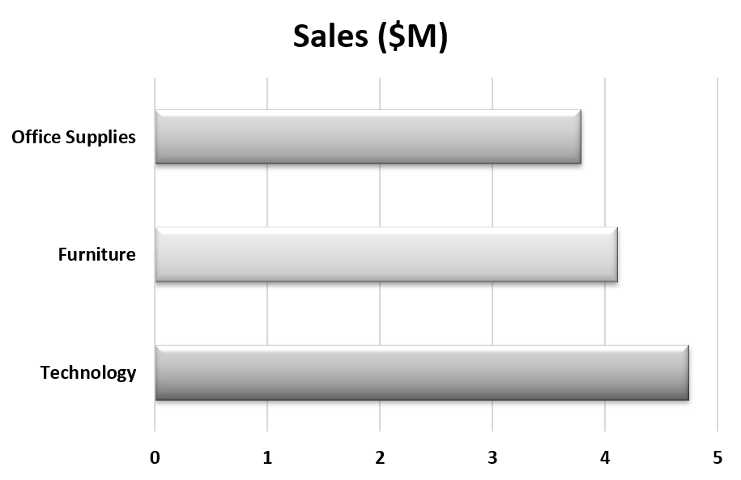
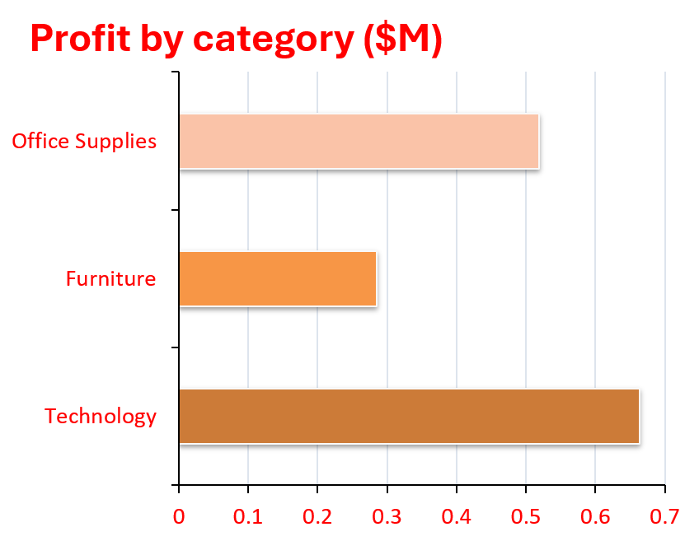
CATEGORY BREAKDOWN
Technology contributes 43.2% of total sales and 52.6% of total profit

Slide 9
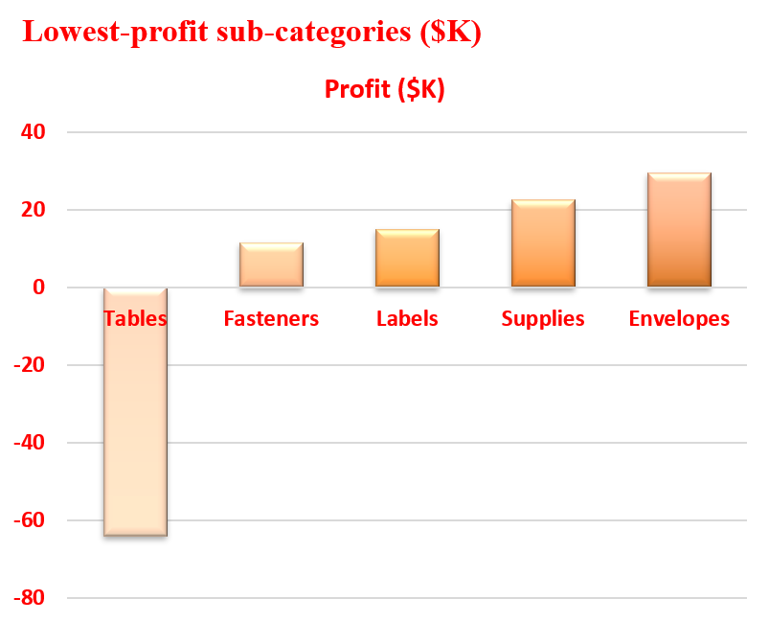
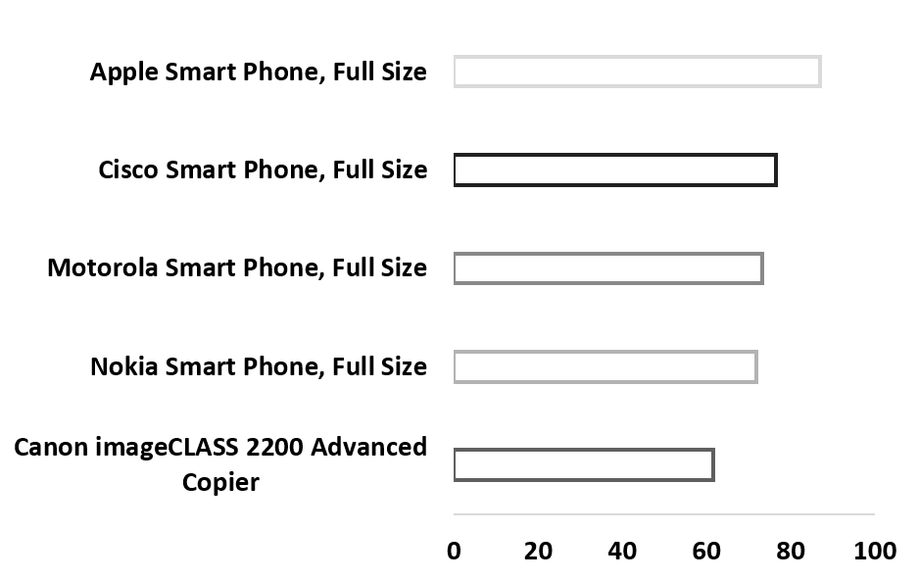
CATEGORY BREAKDOWN
Top products and profit watchlist
WATCHLIST:
TABLES RECORDS THE LARGEST SUB-CATEGORY LOSS AT $9,251; REVIEW DISCOUNTING, COSTS AND PRODUCT MIX BEFORE INCREASING SALES

Slide 10

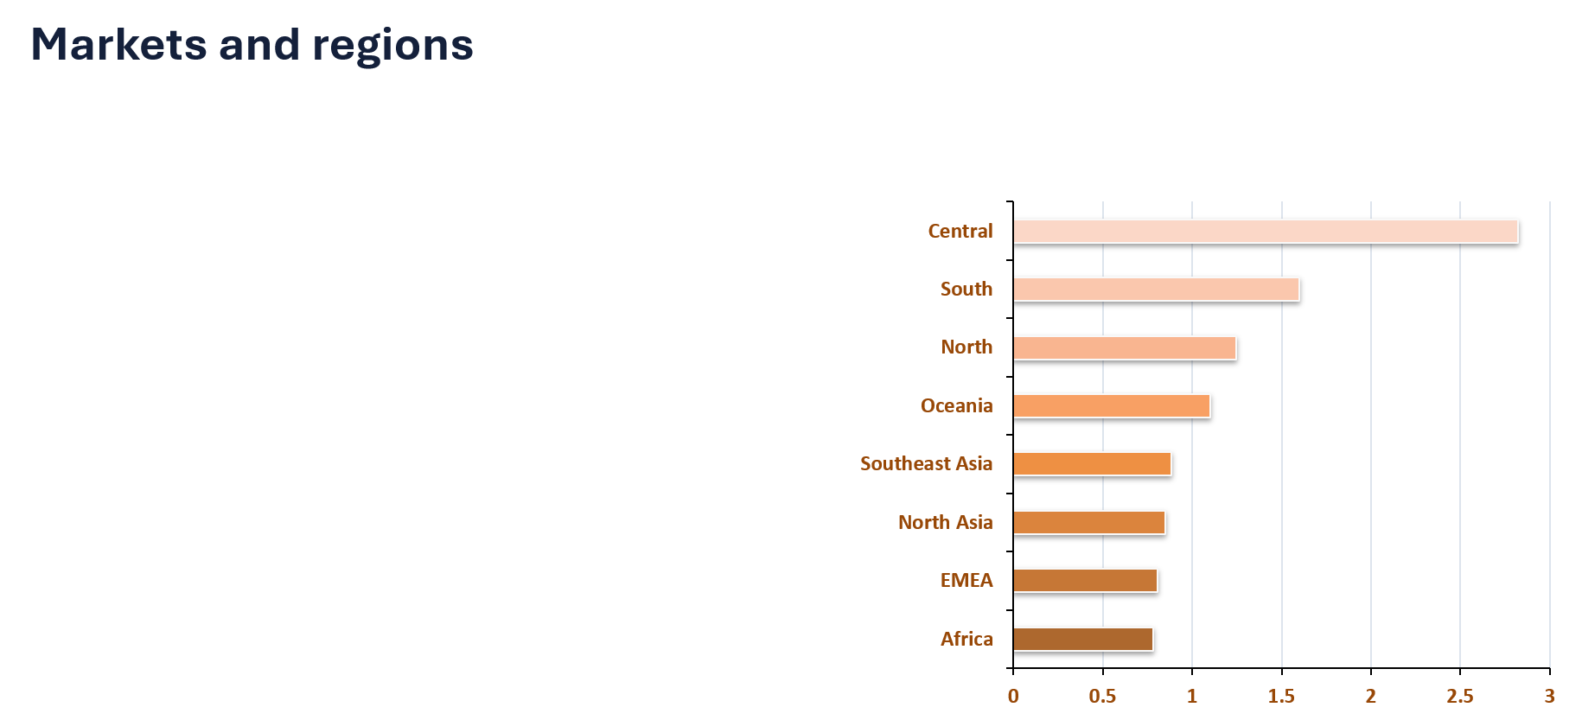

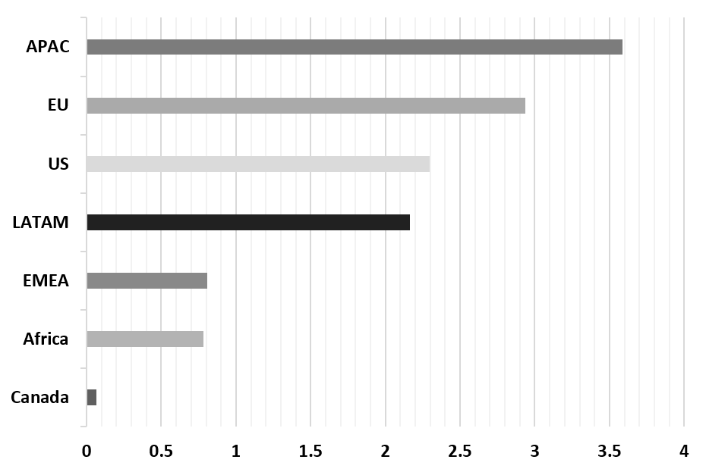
CATEGORY BREAKDOWN
Markets and regions
LEADING MARKET :
APAC ($1.93M SALES). LEADING REGION:
CENTRAL ($1.28M SALES).

Slide 11
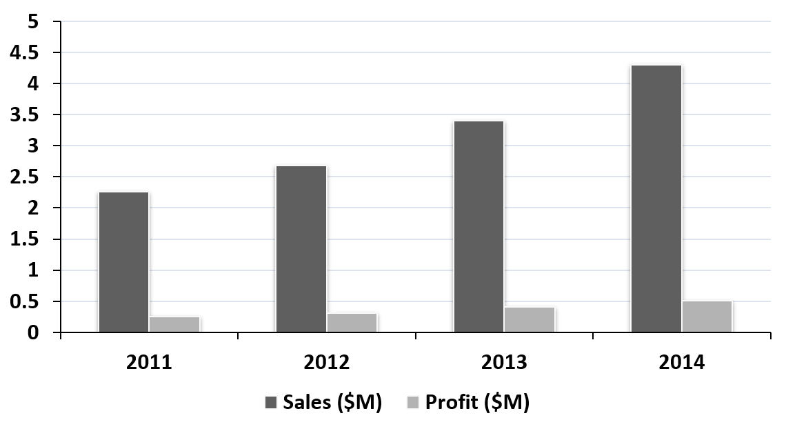
GROWTH TREND
Sales Growth
86%
2011-2014
Profit Growth
91%
2011-2014
SALES INCREASED FROM $1.09M IN 2011 TO $2.03M IN 2014. PROFIT ROSE FROM $0.15M TO $0.30M.

Slide 12


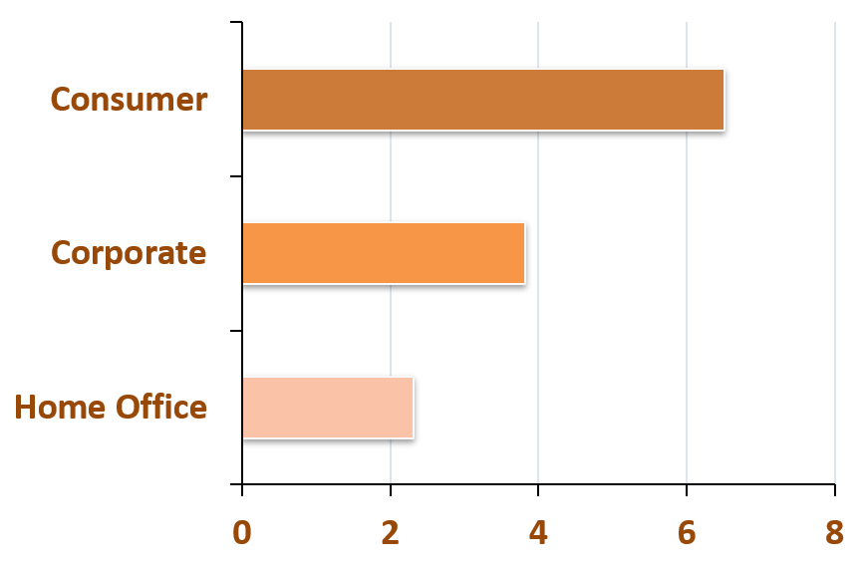
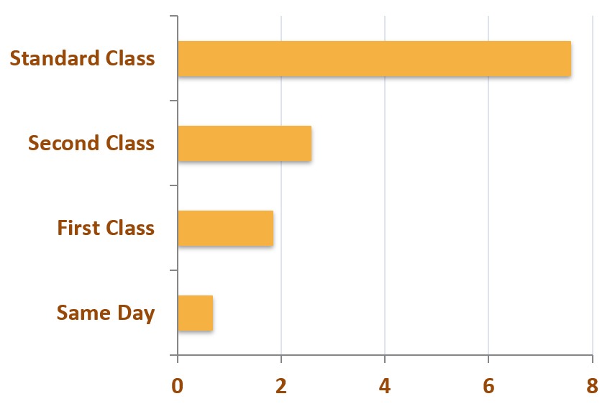
SEGMENT AND SHIP MODE ANALYSIS
CONSUMER SEGMENT: 50.8% OF SALES. STANDARD CLASS: 52.6% OF SALES.

Slide 13

WHAT
WE FOUND
TECHNOLOGY LEADS
Highest category sales and profit in this dataset
APAC LEADS MARKETS
GROWTH IS CONSISTENT
Largest market sales total; investigate which countries and products drive it.
Annual sales and profit rose each year from 2011 through 2014
TABLES NEED ATTENTION
Tables has the largest negative sub-category profit; assess discount and cost patterns.

Slide 14
THANK YOU
For your attention

